Slide 1

OASIS and Coupling with CROCO
CROCO Coupling Team
G. Cambon, S. Jullien, M. Lecorre ,L. Renault
Advance Summer School, Chile 2022

Slide 2
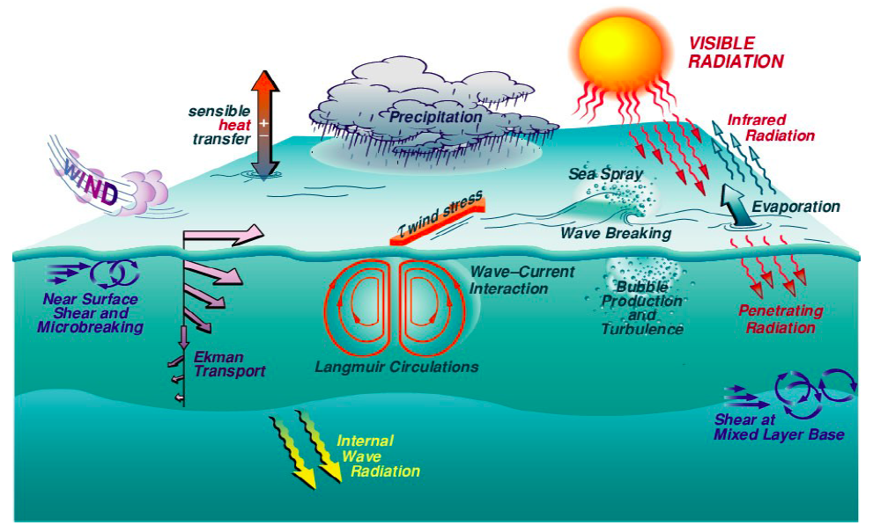
Why do we want to couple ?

Slide 3
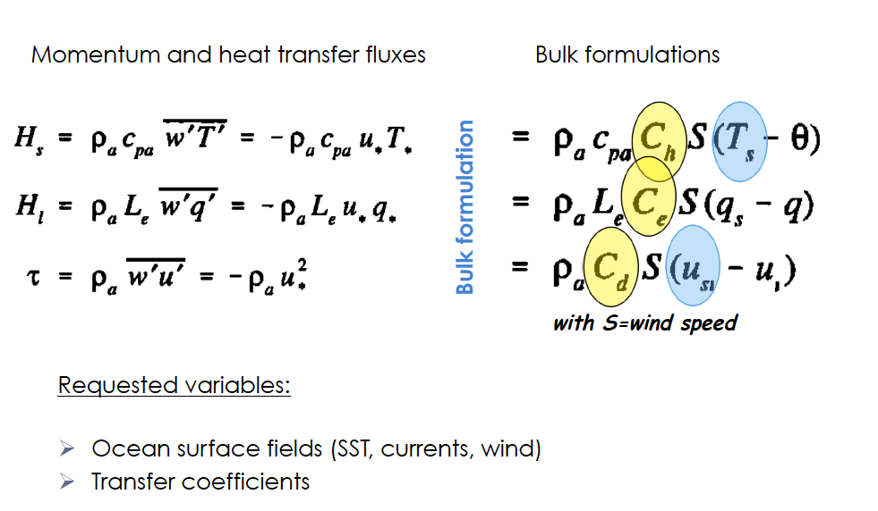
Parameterization of energy transfer between the air-sea interface

Slide 4
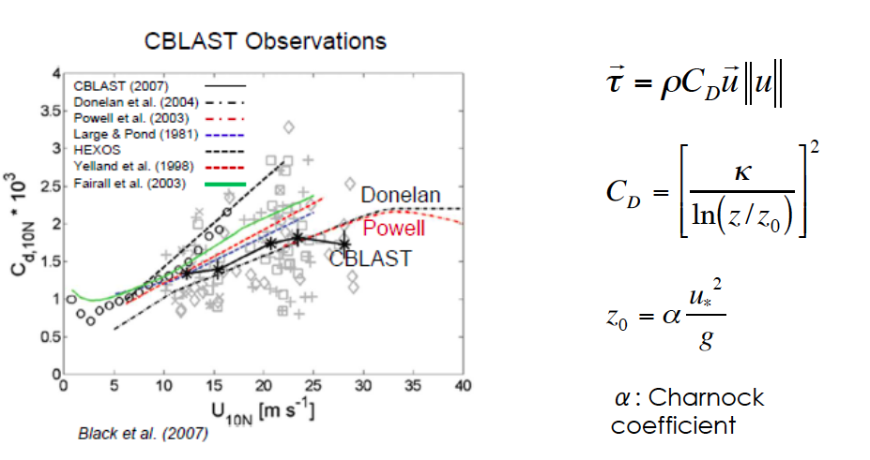
Parameterization of energy transfer between the air-sea interface

Slide 5
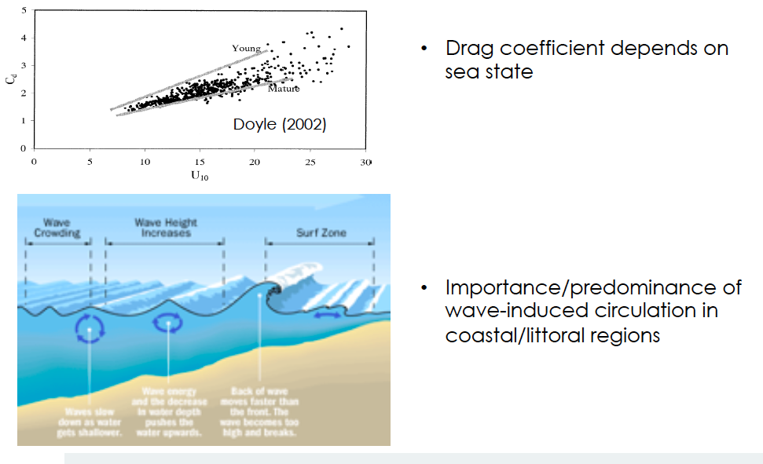
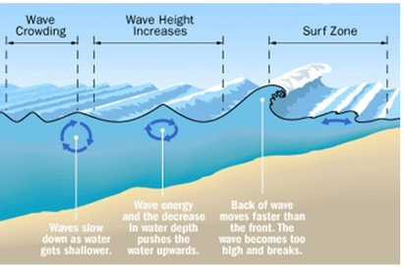
Wave Feedback

Slide 6
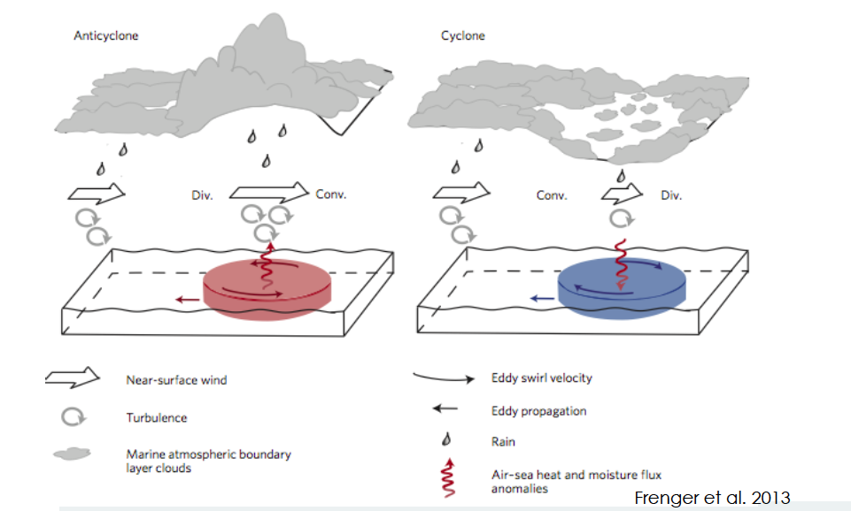
Thermal Feedback

Slide 7
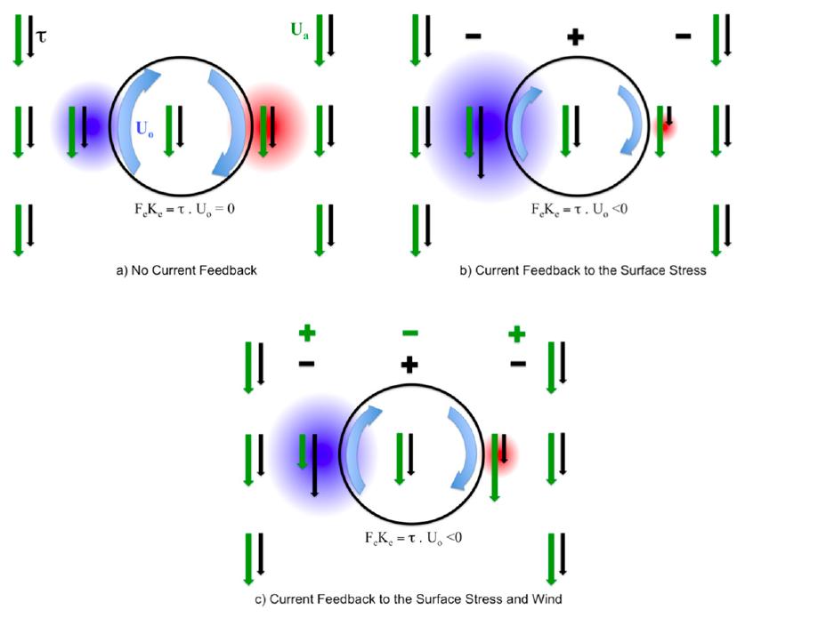
Mechanical Feeback
Renault et al., 2016a

Slide 8
Why do we want to couple
Strong 2-way ocean-atmosphere interactions
  At (sub)mesoscale
  Extreme events
  In the tropics
Strong 2-way interactions between waves and currents
  In frontal regions
  In coastal regions
  In strong current regions
Bulk formulations only valid under some condition
  Moderate wind conditions (except for some formulations developed for high winds)
  fully developed waves
  Relatively large spatial scales
  Relatively low frequency O(day)
  What happens in other conditions?

Slide 9
Processes to model when coupling
Ocean - Atmosphere
  SST feedback to heat flux computation in the atmosphere
  Current feedback to momentum flux computation
  Water flux taking into account rainfall from the atmospheric model
  Solar flux from the atmospheric model
Wave - Atmosphere
  Roughness evolution according to sea state
  Sea spray

Slide 10
Processes to model when coupling
Ocean - Wave
  Impact of evolving water level on waves
  Impact of current on waves evolution (refraction, etc)
  Wave-induced circulation (stokes drift and transport, acceleration by breaking)
  Enhanced mixing due to wave breaking
  Surface and bottom streaming (wave-induced thin viscous boundary layer)
  Mass flux due to wave rollers
  Wave-induced pressure effects
  Wave-induced additional diffusivity
  Wave-induced setup

Slide 11
Coupling implementation scheme
  Exchanged fields
ATM
SST, currents
Winds
Charnock parameter
Surface heat, momentum and water fluxes
OASIS
OCEAN
Currents, water level
WAVES
Significant wave height, mean period, mean direction, momentum fluxes
(stokes transport, brenouilli head pressure …)

Slide 12
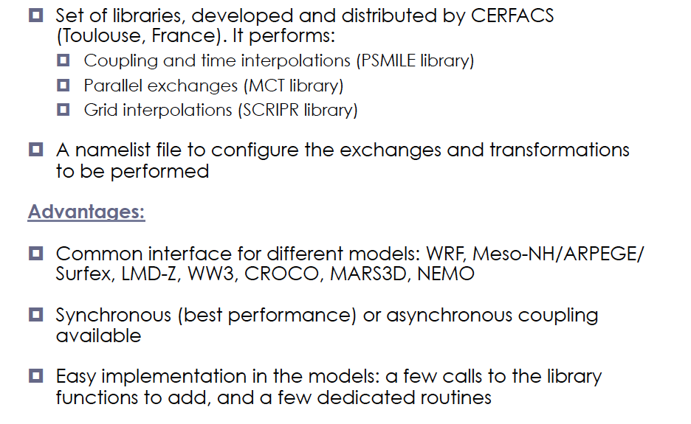
The OASIS Coupler

Slide 13
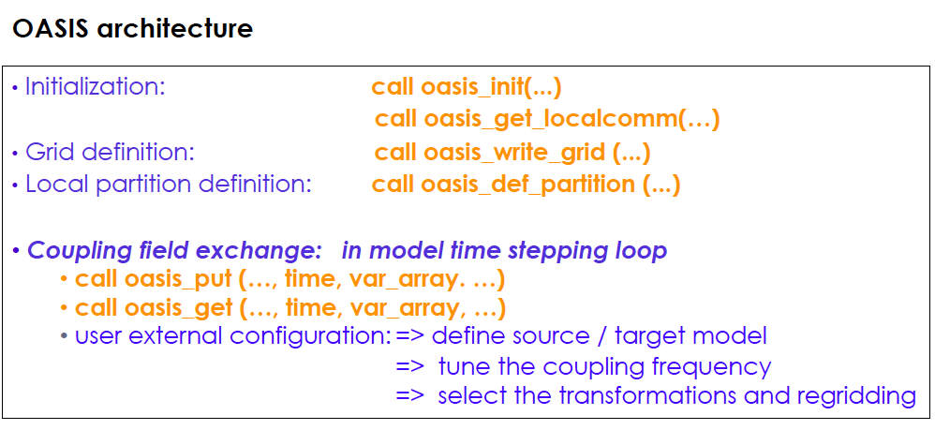
The OASIS Coupler

Slide 14
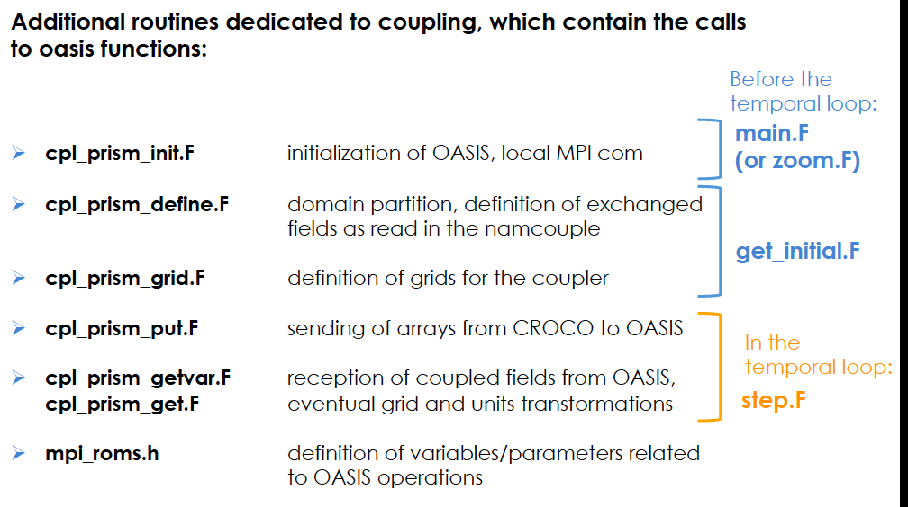
The OASIS Coupler

Slide 15
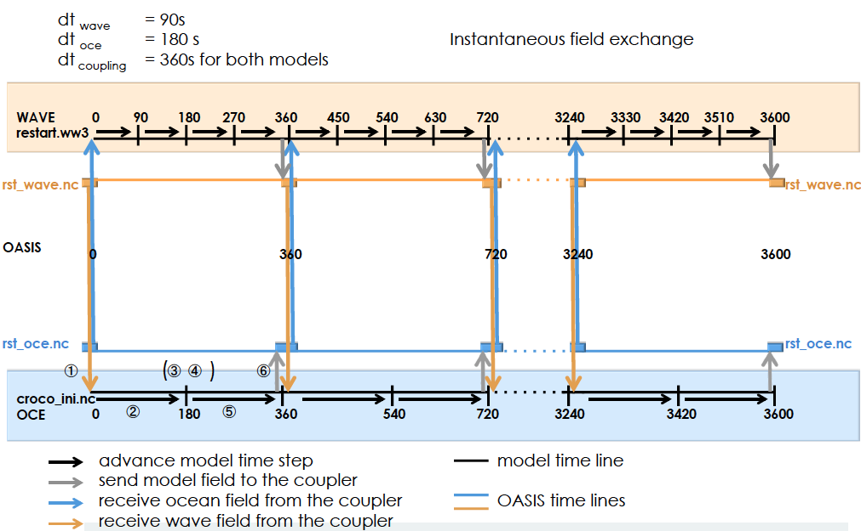
Schematic picture of the coupling sequence

Slide 16
Steps to setup a coupled simulation
Get source codes
Set-up your configuration architecture and environment using: croco/create_config.bash (all-prod-cpl option)
Compile OASIS
Compile your models in coupled mode (with the same netcdf libraries and compilers, NB: CROCO can alternatively be compiled when launching the run within the coupling toolbox)
Perform pre-processing for your different models
Use the coupling toolbox to set-up and run your coupled

Slide 17
Steps to setup a coupled simulation
Get source codes
Suggested architecture:
mkdir $HOME/croco
mkdir $HOME/oasis
mkdir $HOME/wrf
mkdir $HOME/ww3
mkdir $HOME/CONFIGS
OASIS
cd $HOME/oasis
git clone https://gitlab.com/cerfacs/oasis3-mct.git
WRF
cd $HOME/wrf
git clone https://github.com/wrf-croco/WRF.git
WPS
git clone https://github.com/wrf-model/WPS.git
git checkout tags/v4.2
CROCO
cd $HOME/croco
https://www.croco-ocean.org/croco-project/
tar -zxvf croco-v1.0.tar.gz
tar -zxvf croco_tools-v1.0.tar.gz
Or
git clone https://gitlab.inria.fr/croco-ocean/croco.git
git clone https://gitlab.inria.fr/croco-ocean/croco_tools.git
WW3
cd $HOME/ww3
git clone https://github.com/NOAA-EMC/WW3

Slide 18
Steps to setup a coupled simulation
(2) Set-up your configuration architecture and environment using: croco/create_config.bash (all-prod-cpl option)
-> useful to get paths, env var, and scripts to facilitate compilation, etc)
cd $HOME/CONFIGS
cp $HOME/croco/croco/create_config.bash
Edit create_config.bash : paths, settings
./create_config.bash
You should now have YOUR_CONFIG directory
cd $HOME/CONFIGS/ YOUR_CONFIG
Check the myenv_mypath.sh file, eventually edit path if necessary

Slide 19
Steps to setup a coupled simulation
(3) Compile OASIS
OASIS
cd $HOME/oasis/oasis3-mct/oasis3-mct/util/make_dir
cp $HOME/croco/croco/SCRIPTS/SCRIPTS_COUPLING/OASIS_IN/make.DATARMOR .
Check the paths in make.DATARMOR
In make.inc set the include to the absolute path of your make.DATARMOR:
include $(home)/oasis/oasis3-mct/util/make_dir/make.DATARMOR
Compilation:
make realclean -f TopMakefileOasis3 > oasis_clean.out
make -f TopMakefileOasis3 > oasis_make.out

Slide 20
Steps to setup a coupled simulation
OPTION 2 : “A la mano” with some help
(4) Compile WRF
cd $HOME/wrf/WRF
A few scripts are provided to help you compile : First set a few environment variables:
cat $HOME/croco/croco/SCRIPTS/SCRIPTS_COUPLING/SCRIPTS_TOOLBOX/MACHINE/DATARMOR/myenv.DATARMOR* myenv.sh
source myenv.sh
Then copy the appropriate configure files :
cp $HOME/croco/croco/SCRIPTS/SCRIPTS_COUPLING/WRF_IN/CONFIGURE_WRF/DATARMOR/* .
./clean –a
cp configure.wrf.uncoupled configure.wrf
./compile em_real > compile_uncoupled.log
./clean -a
cp configure.wrf.coupled configure.wrf
./compile em_real > compile_coupled.log
OPTION 1 : “A la mano”
cd $HOME/wrf/WRF
Classical compilation :
./clean –a
./configure
Check and eventually edit configure.wrf, then:
./compile em_real
OPTION 3: using provided scripts
cd $HOME/CONFIGS/YOUR_CONFIG
Check your paths in myenv_mypath.sh
cd WRF_IN
qsub DATARMOR.compile.wrf.pbs

Slide 21
Steps to setup a coupled simulation
OPTION 2 : “A la mano” with some help
(4) Compile WPS
cd $HOME/wrf/WPS
A few scripts are provided to help you compile : First set a few environment variables:
cat $HOME/croco/croco/SCRIPTS/SCRIPTS_COUPLING/SCRIPTS_TOOLBOX/MACHINE/DATARMOR/myenv.DATARMOR* myenv.sh
source myenv.sh
Then copy the appropriate configure files :
cp $HOME/croco/croco_tools/Coupling_tools/WRF_WPS/configure.wps.MACHINE .
./clean –a
cp configure.wrf.MACHINE configure.wps
./compile > compile_wps.log
OPTION 1 : “A la mano”
cd $HOME/wrf/WPS
Classical compilation :
./clean –a
./configure
Check and eventually edit configure.wps, then:
./compile

Slide 22
Steps to setup a coupled simulation
(4) Compile CROCO
OPTION 1 : “A la mano”
OPTION 2 : automatic compilation when running
cd $HOME/CONFIGS/YOUR_CONFIG/CROCO_IN
Check and edit :
param.h => grid and MPI settings
cppdefs.h => CPP options
jobcomp.h => paths and compilers
Compile
./jobcomp
Eventually move the executable to another name :
mv croco croco.frc
or
mv croco croco.ow
In $HOME/CONFIGS/YOUR_CONFIG/mynamelist.sh
You can set online compilation of CROCO:
# Online Compilation
export ONLINE_COMP=1

Slide 23
Steps to setup a coupled simulation
(5) Preprocessing
CROCO
cd $HOME/CONFIGS/YOUR_CONFIG/PREPRO/CROCO
Check and edit paths in start.m
Check and edit settings and paths in crocotools_param.m
In matlab for climatological input files :
start
make_grid
make_forcing
make_bry
make_ini
WRF
cd $HOME/CONFIGS/YOUR_CONFIG/PREPRO/WRF_WPS
Rename and edit configure.namelist.wps_BENGUELA for your own configuration
Check and edit settings and paths in run_wps.bash
Check CPUs in job.wps.pbs and launch it: qsub job.wps.pbs
WW3
Follow WW3 preprocessing tutorial
Or eventually create grid files from croco grid with:
make_ww3_grd_input_files_from_croco_grd.m

Slide 24
Steps to setup a coupled simulation
(6) Coupling toolbox philosophy and workflow:
The user edit:
* myenv_mypath.sh : environment settings, and paths
* mynamelist.sh : settings for the experiment (which models, time stepping, input files…)
* myjob.sh : settings for the job (dates notably)
Then the user launch the job with
The coupling toolbox manages:
CROCO compilation if requested
getting models input files
preparing OASIS restart files
editing namelists (for models and OASIS)
launching the run
putting output files
eventually looping for another job
./submitjob.sh

Slide 25
Steps to setup a coupled simulation

Slide 26
What to check in case of error…
In case of error, you should check:
----------
The job output file: in $HOME/CONFIGS/YOURCONFIG/jobs_YOUREXPER : YOUREXPER_YYYYMMDD_YYYYMMDD.o*
The models’ log files: either in $HOME/CONFIGS/YOURCONFIG/jobs_YOUREXPER/YYYYMMDD_YYYYMMDD or in $WORKDIR/CONFIGS/YOURCONFIG/rundir/YOUREXPER_execute/YYYYMMDD_YYYYMMDD
  croco.log rsl.error.0000 log.ww3
OASIS log files:
nout.000000 debug.0?.000000
----------
Typical issues are:
Files not found: check your file names, and location
Unconsitent dimensions of the grids in the different files: check models grid files, OASIS grids and masks files, OASIS remapping weight files, namelists of models and OASIS (namcouple)
Unconsistency in exchanged variables: check namcouple
Model blow up: check the log files, if blow up is due to CFL (unrealistic speed, or segmentation fault) decrease the model time step

Slide 27
References
Example of CROCO Online documentation
http://www.croco-ocean.org/documentation/
A few references:
  Jullien et al., 2020
  Renault et al., 2016ab,…,2020ab
  Seo et al., 2016, 2017
  Masson et al., in preparation
  Voldoire et al. 2017: Coupling with OASIS within SURFEX (in discussion online):
  http://www.geosci-model-dev-discuss.net/gmd-2017-91/

